Slide 1
Continuous not grid world
agent = MazeAgent(dt=0.05, v=0.1, numRooms=1, roomSize=1, policy='randomWalk')
agent.walls['barrier'] = np.array([[[0.3,0.7],[0.7,0.3]]])
for i in tqdm(range(2000)):
agent.movementPolicyUpdate()
fig, ax = agent.plotHistory()
Position is a continuous variable:
Walls are true 1D objects
A check is done on each step to handle wall collisions
A function maps continuous position to a (quantized?) state-rep, e.g. one-hot

Slide 2
Generalised SR-TD
Use general SR form. M is a matrix which maps some state vector onto another vector which I the discounted summer future occupancy
I.e. Ψ(S) is:
So we can learn Ψ(S) by standard TD methods
Or as a direct learning rule on M, this is can be rewritten as (assuming rescaling of α or normalised state vectors)
All that remains is to show that with one-hot numbered states, f(S_{t})_{i} = δ(i = S_{t}), standard SR equation comes out.
Shouldn’t matter if f is not normalised as this is absorbed into alpha
e.g. de Cothi 2020, it’s what I’m implementing
matrix columns give future occupancy i.e. place fields
e.g. Stachenfeld 2017

Slide 3
Place cells and grid cells
agent.alpha = 0.2
agent.gamma = 0.99
agent.dx = 0.1
for i in tqdm(range(100000)):
agent.movementPolicyUpdate()
agent.TDLearningStep()
fig, ax = agent.plotPlaceField()
fig, ax = agent.plotGridField()
γ = 0.9
γ = 0.999
Place cells leak over barrier since positions on either side of the barrier can map to same state rep

Slide 4
Two rooms
agent.doorsClosed = True
agent.doorsClosed = False
Biggest problems:
• Can be slow to train
• Defining position to state rep function non-trivial (I guess that’s the whole point)

Slide 5
Four rooms
Biggest problems:
• Can be slow to train
• Defining position to state rep function non-trivial (I guess that’s the whole point)

Slide 6
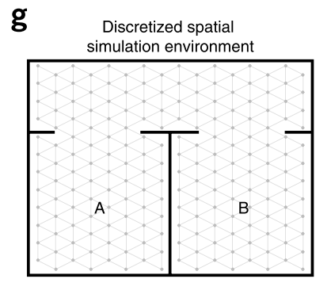
Grid cells bleeding across boundaries
Vertical / horizontal boundaries only ☹
Biggest problems:
• Can be slow to train
• Defining position to state rep function non-trivial (I guess that’s the whole point)

Slide 7
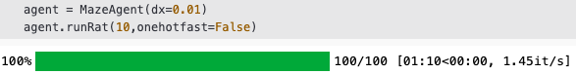
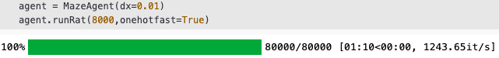
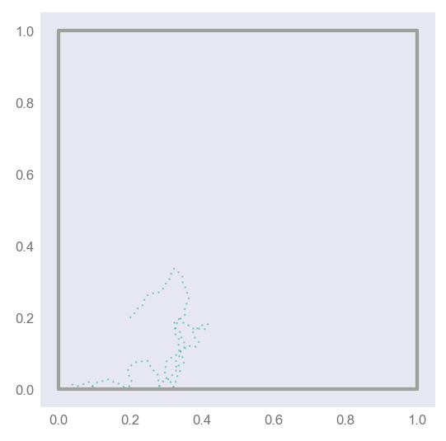
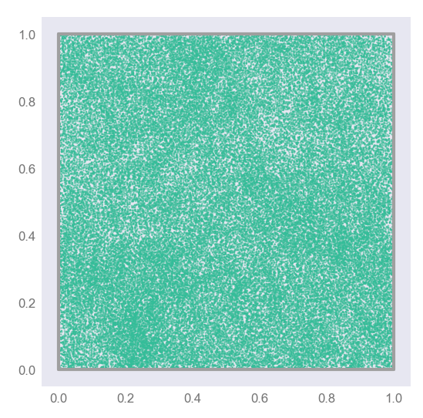
Code speed-up, O(1000x)
General formula:
One-hot specific formula:
Biggest problems:
• Can be slow to train
• Defining position to state rep function non-trivial (I guess that’s the whole point)

Slide 8
Motion models
Random Walk
Raudies
Windows screensaver

Slide 9
New mazes
Explore
Place
Grid

Slide 10
Continuous time and state TD learning:
Discrete state (one-hot)
Discrete time
Continuous state (e.g. BVCs)
Discrete time
Continuous state and time
e.g. Doya, 1996
Decouples γ from dt, i.e. decouples learning from the motion model

Slide 11
Proof:
normalised
Logical continuous-time
analogue
True if our estimate of Ψ, is correct
If it isn’t, we should update it (TD learning)
Re-discretising we get:
Or equivalently:
#time-step independent TD update
delta = state + (self.tau / dt) * (self.M @ ((1 - dt/self.tau)*state - prevState))
self.M = self.M + alpha * np.outer(delta, state)

Slide 12
Independence on dt
dt = 0.01
dt = 0.1
dt = 0.2
Dependence on τ
Tau = 1s
Tau = 2s
Tau = 4s

Slide 13
If τ → 0, Ψ → f
Zero iff:
Equivalent proof

Slide 14
Biologically inspired basis sets
In Will and Caswell’s neurobiological successor feature paper place cells are define as:
I.e. each row is a different (thresholded) successor features. We call this a “place cell”.
There is one place cell corresponding to each basis cell (BVC, HDC or whatever)

Slide 15
Successor features as a “causality obeying” smoothing convolution
Ψ (place cell) is essentially f (basis cell) “smoothed” with an exponential kernel
The smoothing is predominantly along directions likely to be visited in the near future.
RandomWalk
Raudies

Slide 16
Gaussian receptive field basis (and a new colour map)
Learned ‘place cells’
Threshold = 0.5 max
Basis cells
Bonus, resolution independent
(here 1mm precision)
All place
field locations
Successor
matrix

Slide 17
Fourier basis
Basis cells (100 cells)
Learned ‘place cells’
Bonus, resolution independent
(here 1mm precision)

Slide 18
Circle basis
Basis cells (100 cells)
Learned ‘place cells’
No threshold on place cells for clarity.
Biologically implausible but easy to
see the ‘smoothing effect’
τ = 1 therefore smoothing distance roughly v• τ = 0.16m

Slide 19
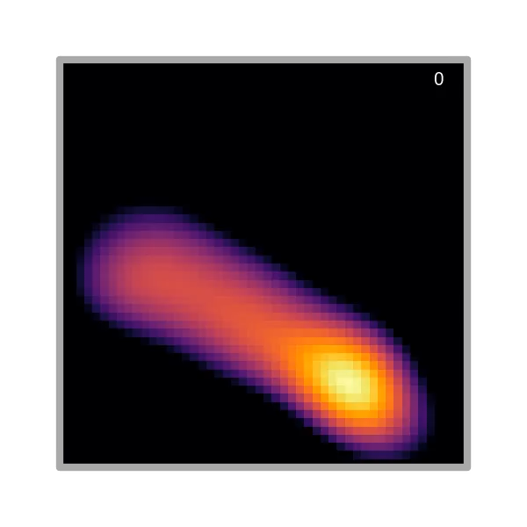
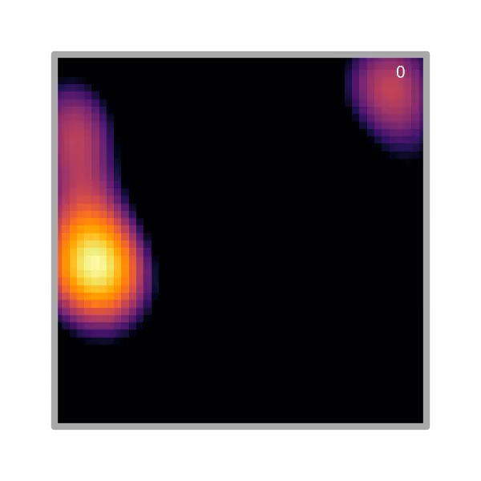
The birth of a place cell
Constant α
Exponentially decaying α

Slide 20
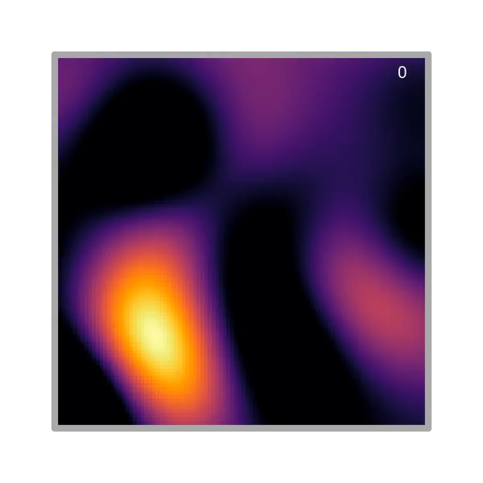
The birth of a grid cell

Slide 21


Implementing circular maze without corners
=
=

Slide 22
Circular maze

Slide 23
Circular maze

Slide 24
Separated simulation time step from TD learning
if np.linalg.norm(self.pos - hist_pos[lastTDstep]) >= 0.02: #if it's moved over 2cm meters from last step
dt_TD = self.t - hist_t[lastTDstep]
self.TDLearningStep(pos=self.pos, prevPos=hist_pos[lastTDstep], dt=dt_TD, tau=self.tau, alpha=alpha_)
lastTDstep = i

Slide 25
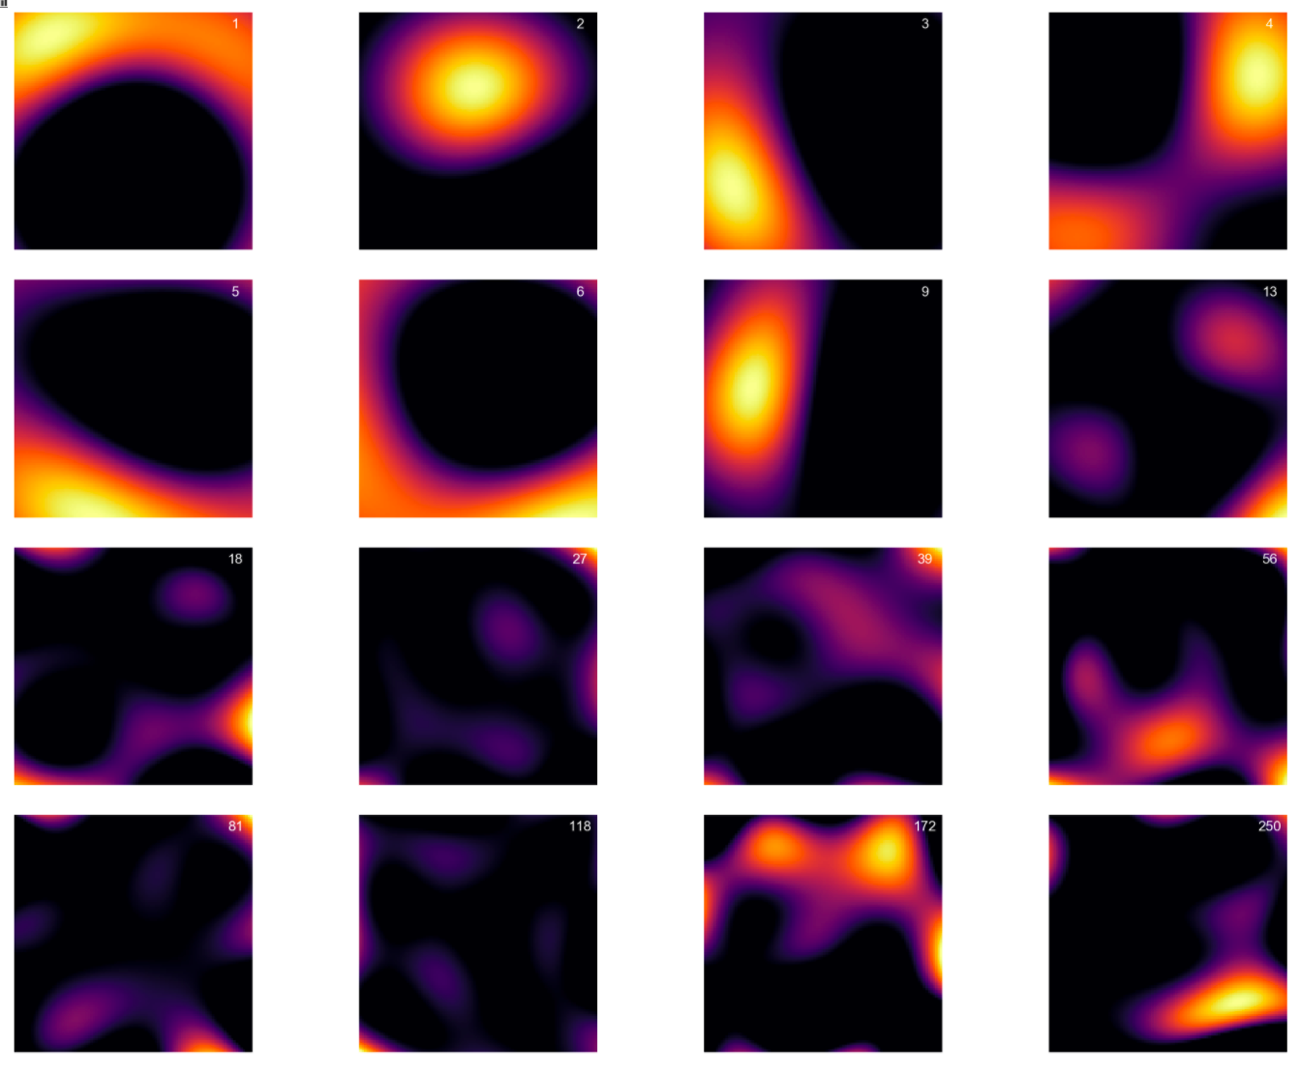
Fixed numerical instabilities
Place fields arranged by x-location

Slide 26
I’m confident in loop maze results now
Rat runs for 100 minutes in ’loop’ maze.
TD learning step every 2cm
Turn down rotational velocity so rat moves up and down maze
Grid cells primarily one dimensional
“End cells”
Boundary cells

Slide 27
Comparison of loop open to loop closed

Slide 28
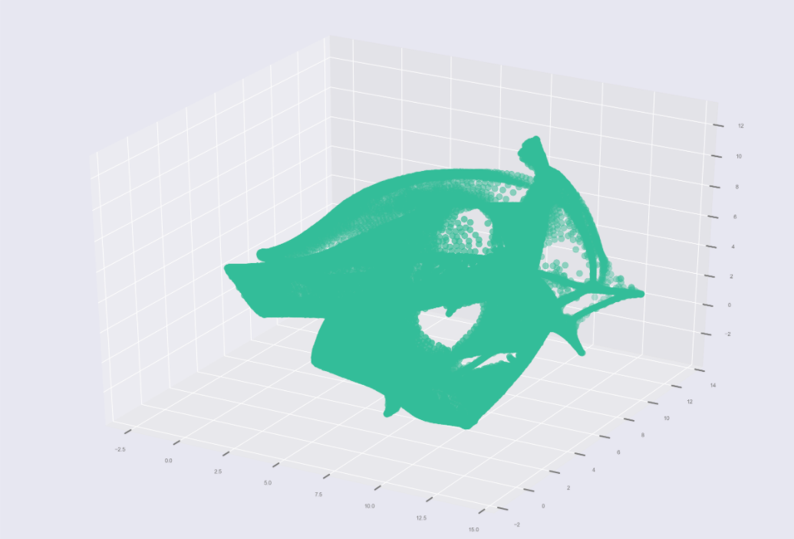
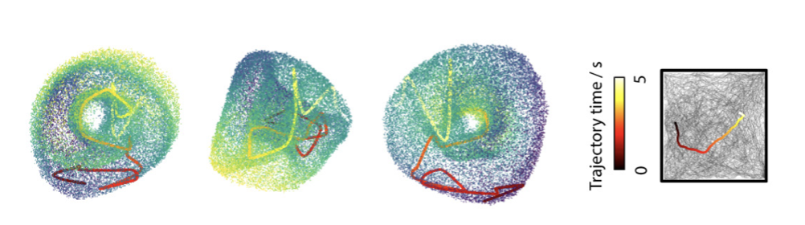
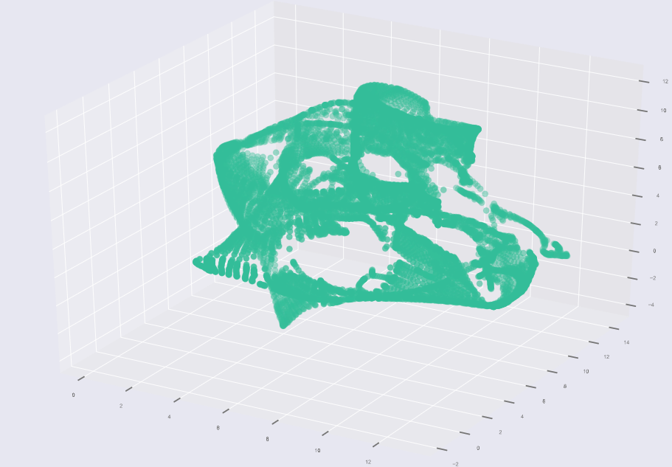
Torus ?
Similar grid cells → top 6 PCAs → UMAP 3D
Probably need to filter grids by “griddyness” and group into period modules. Then this would work.

Slide 29
Loop opening/closing experiment
Closed loop exploration
(1hr)
Loop door opens
(10 mins)
Loop door closes again
(10mins)

Slide 30
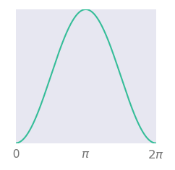
Theta modulation
Place field
Theta phase =
Preferred phase
(neuron i)
Rat path
Firing rate =
20Hz
Place cell firing rate
( = 1 in centre of cell)
Theta modulation,
(=1 at preferred theta phase)
σ_{θ} = π/3

Slide 31
Phase precession
Threshold gaussian place fields

Slide 32
Theta sweeps

Slide 33
Inhomogeneous Poisson spike train sampling
Simulation saves firing rate.
Spike train sampling and STDP done post hoc
Zoom in and increase spike rate 10x

Slide 34
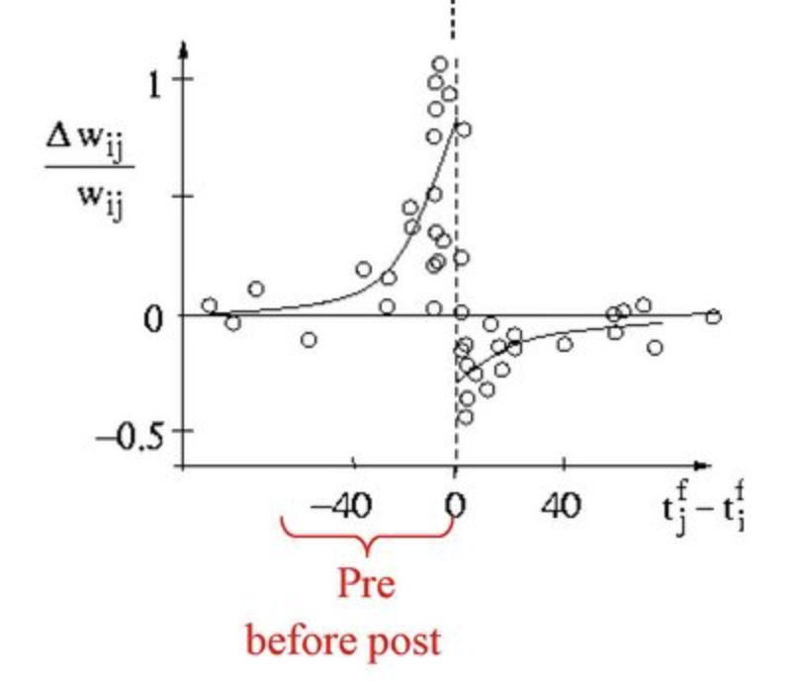
Online-STDP
I haven’t really looked into this. I’m probably making mistakes
10ms
strengthen
weaken
strengthen
a lot
weaken
a lot
Each spike updates the neurons exponentially decaying trace
Neuron has a “presynaptic trace” (for strengthening connections when it is the presynaptic neurons) and a “post synaptic” trace for weakening connections when it is the postsynaptic neurons.
Strengthening due to pre-post alignment stronger than weakening due to post-pre

Slide 35
Online-STDP
Arrange spikes in time order
For every spike, i:
Get spike neuron identity,
Get spike time,
Update traces. Exponential decay + delta iff neuron is the one spiking
Pre-to-post updates:
Post-to-pre updates:

Slide 36
Experiment 1: Closed loop (10 min)
SR M-matrix (TD learning)
STDP weight matrix

Slide 37
Experiment 2: Open loop, asymmetry (10 min)
SR M-matrix (TD learning)
STDP weight matrix

Slide 38
Experiment 1: Open room (60 min)
This is with equal
amounts of LTD and LTP
SR M-matrix (TD learning)
STDP weight matrix

Slide 39
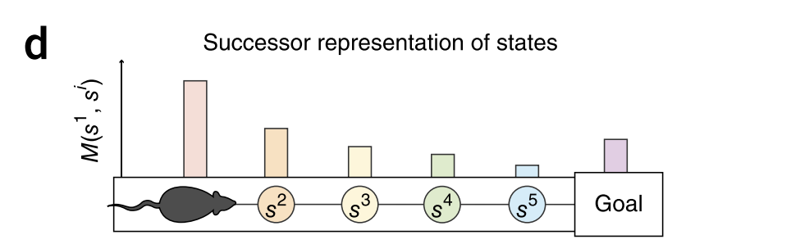
Confusion about transposed SR matrix
As normally defined M(s_{i},s_{j}) = expected future occupancy of state s_{j} given you start in s_{i}
So if s_{j} is ahead of s_{i} in the trajectory, M(s_{i}, s_{j}) should be high. Therefore (as the rat is moving right and place cells arranged left to right) we should expect M to look like this:
In line with other results:
The reason it doesn’t (and is in fact flipped) is that M_{ij} (whats plotted) is not the logical analog to M(s_{i},s_{j}).
Down ⬄ Across

Slide 40
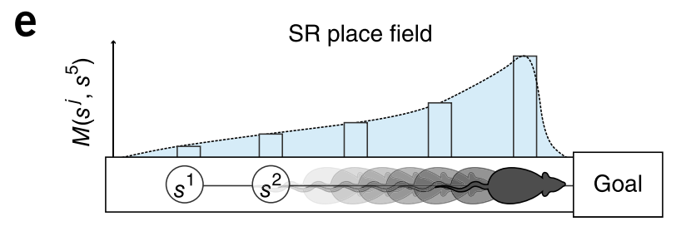
Behaviourally biased place cells
τ = 8s, v = 0.16m/s ==> PC size ~= 1.3m

Slide 41
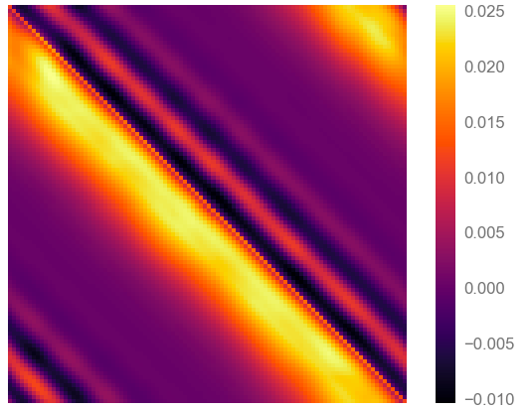
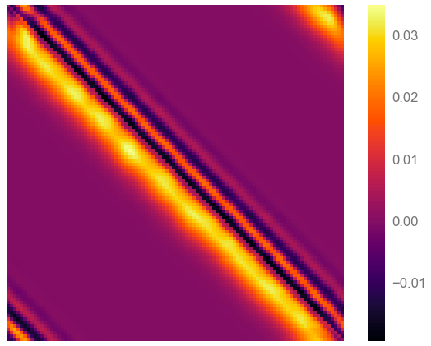
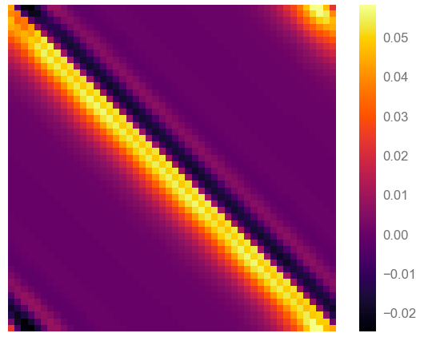
“Banding” size = Basis cell size
N cells = 100
σ_{cell} = 20cm
N cells = 100
σ_{cell} = 10cm
N cells = 50
σ_{cell} = 20cm
Band width proportional to full width of place cell (and independent of their density)
It’s therefore probably a sort of “fourier transform” edge effect since we’re trying to build a discountinous successor feature our of discrete gaussians.
M
Q: For one how the SR is a perfectly discontinuous.
Is this true for diffuse basis cells.
x

Slide 42
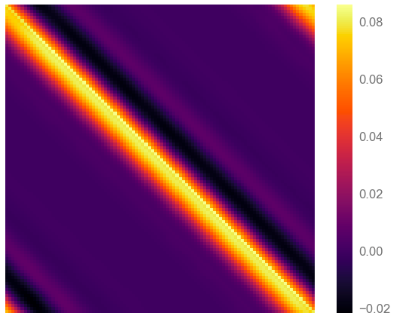
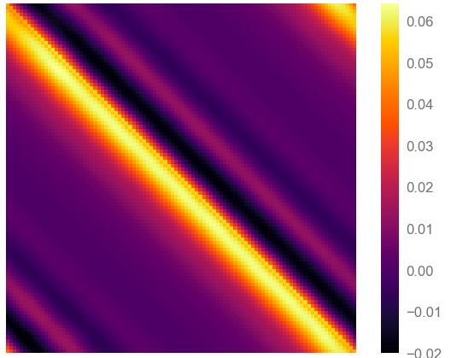
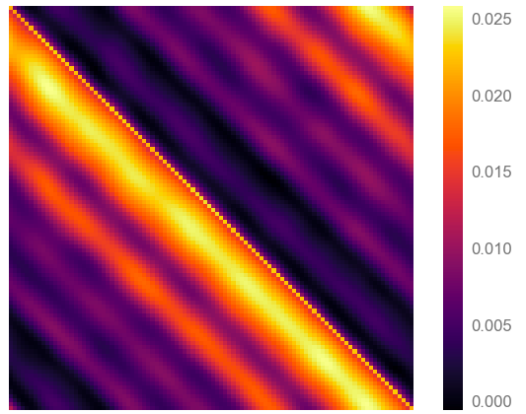
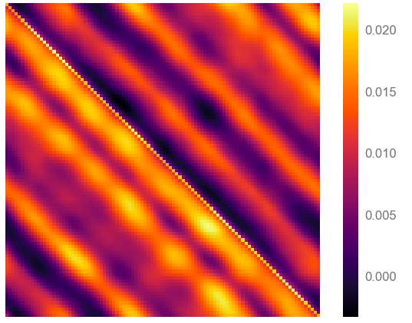
Tau also controls banding
Long tau means cell at x is very unpredictive of the firing of cell x-Δx at future time t + τ
Small tau means cell at x is a little predictive of the firing of cell x-Δx at future time t + τ (since they overlap)
τ = 1s
τ = 2
τ = 8
τ = 20
Though I’m still confused

Slide 43
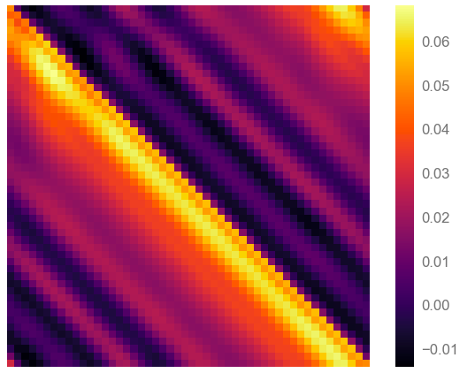
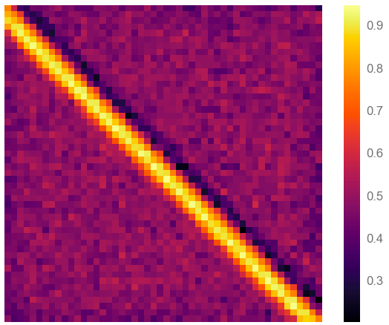
SR-TD vs STDP

Slide 44
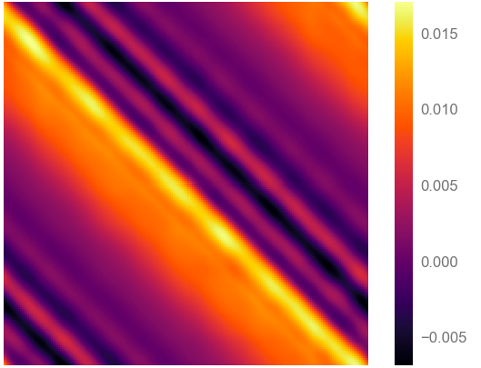
The solution shouldn’t have negatives:
But I’m not sure if it should have a discontinuity
Place cell can be smooth and positive (as a function of x) even if M has negative components
I don’t see any reason why ANY component of (evne those corresponding to feature cells behind current location) should end up negative if the algorithm converged properly.

Slide 45
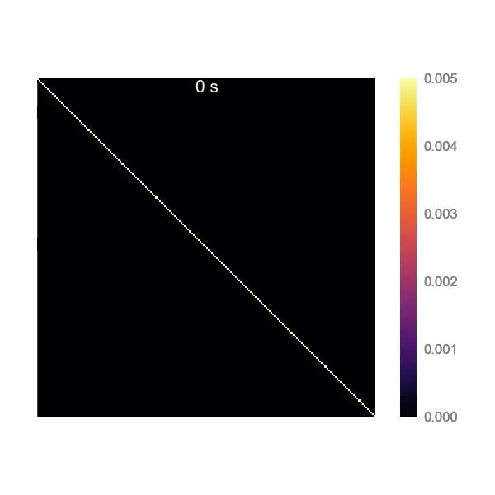

Evolution of instabilities

Slide 46
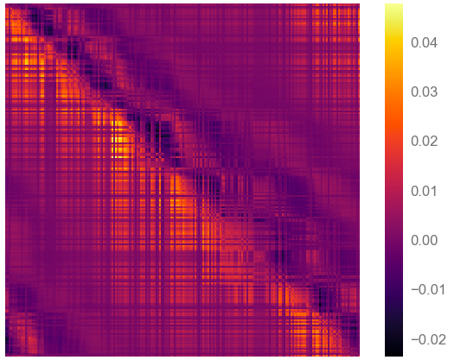
Random cells

Slide 47
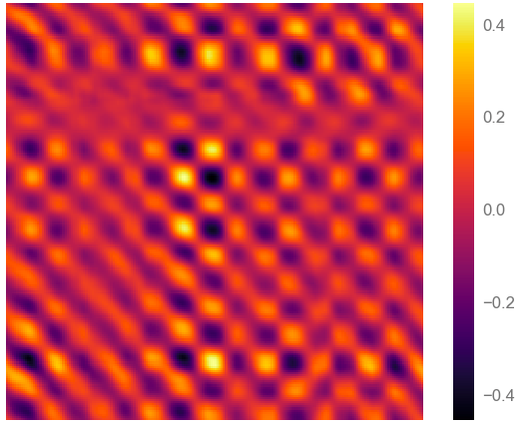
α vs t_{train}
t = 1min
t = 30min
t = 100min
t = 300min
α = 0.1
Banding always precedes instability (I’ve never found ‘stable’ banding)
Conclude that banding is an instability in the learning rule, not a result of the granularity of the basis cells (the fourier mode theory)
α = 0.01
α = 0.001
α = 0.0001
Alpha 0.001, 100 min

Slide 48
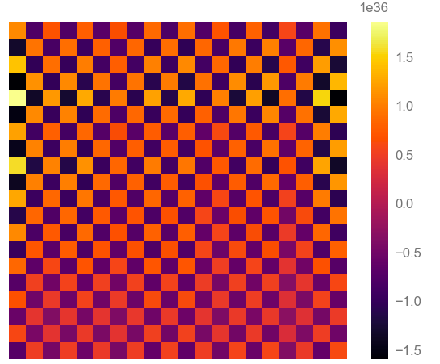
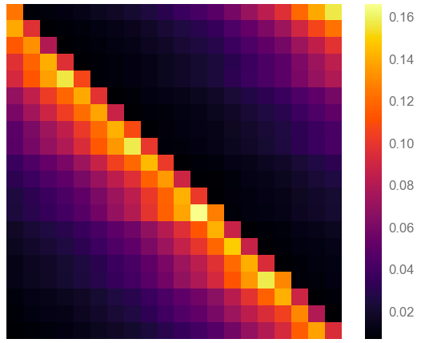
Back to onehots
Using one hot rule
Using general state vector rule
No oscillations but still unstable

Slide 49
New current hypothesis:
A cell far away
This is an instability arising from the feature-version of the TD learning rule. This update rule is matrix-to-matrix.
This means we’re effective updating this cell, based on info info from a transition between location x₁ and x₂
In theory we receive no information about this basis cell and the update to M for it’s corresponding place-cell should be zero BUT if it isn’t zero there’s no mechanism to counter it and the error can grow. Maybe?
The reason we only see oscillation behind the direction of travel is because any errors accumulated on those ahead are quickly remove when we visit these states and do an informative update.
Cells close to current location
x₁
x₂
☹
☺

Slide 50
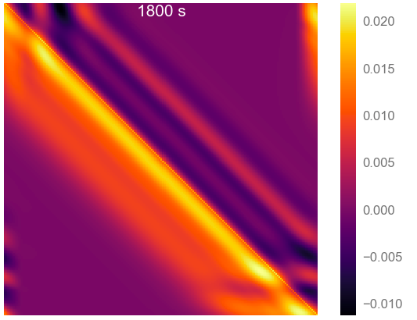
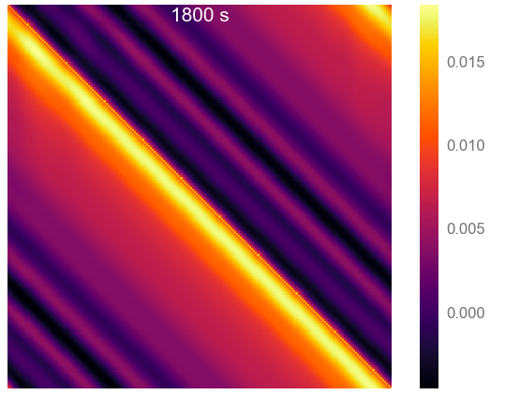
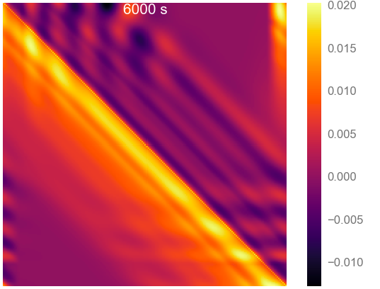
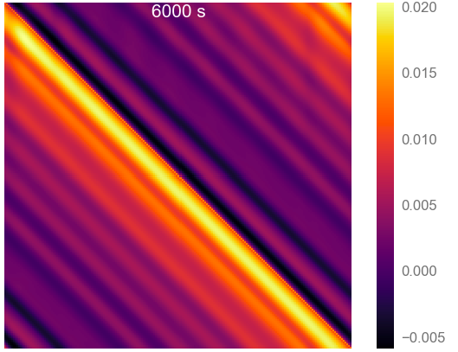
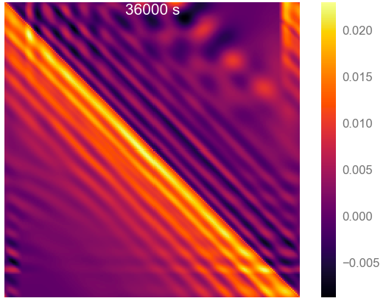
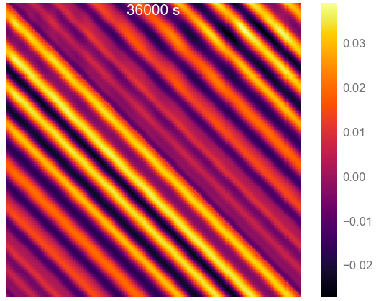
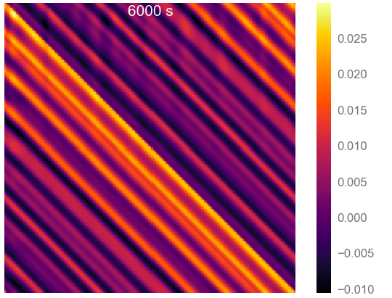
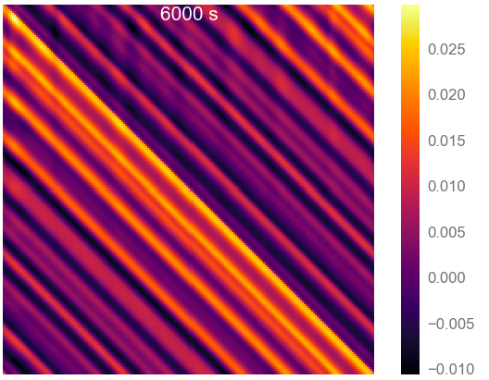
Things I’ve tried:
Masking M updates to place cells far from current location. Maybe works?
Regularisation of M. Nope.
Randomising the TD update order (reduce correlation of updates). Doesn’t help.
Initialise M high. Doesn’t help.
Ask Will if he ever had instabilities?
vs no masking:
self.M = self.M + alpha * (np.outer(delta, state) - 0.1*(self.M**2)*self.M)
Doesn’t really help (and non-BP, non-local updates)

Slide 51
Ignoring that for now: back to STPD
For constant τ:
At constant σ_{basis cell}
At constant v_{rat}

Slide 52
Fixed it!
Correct forms:
I had:

Slide 53
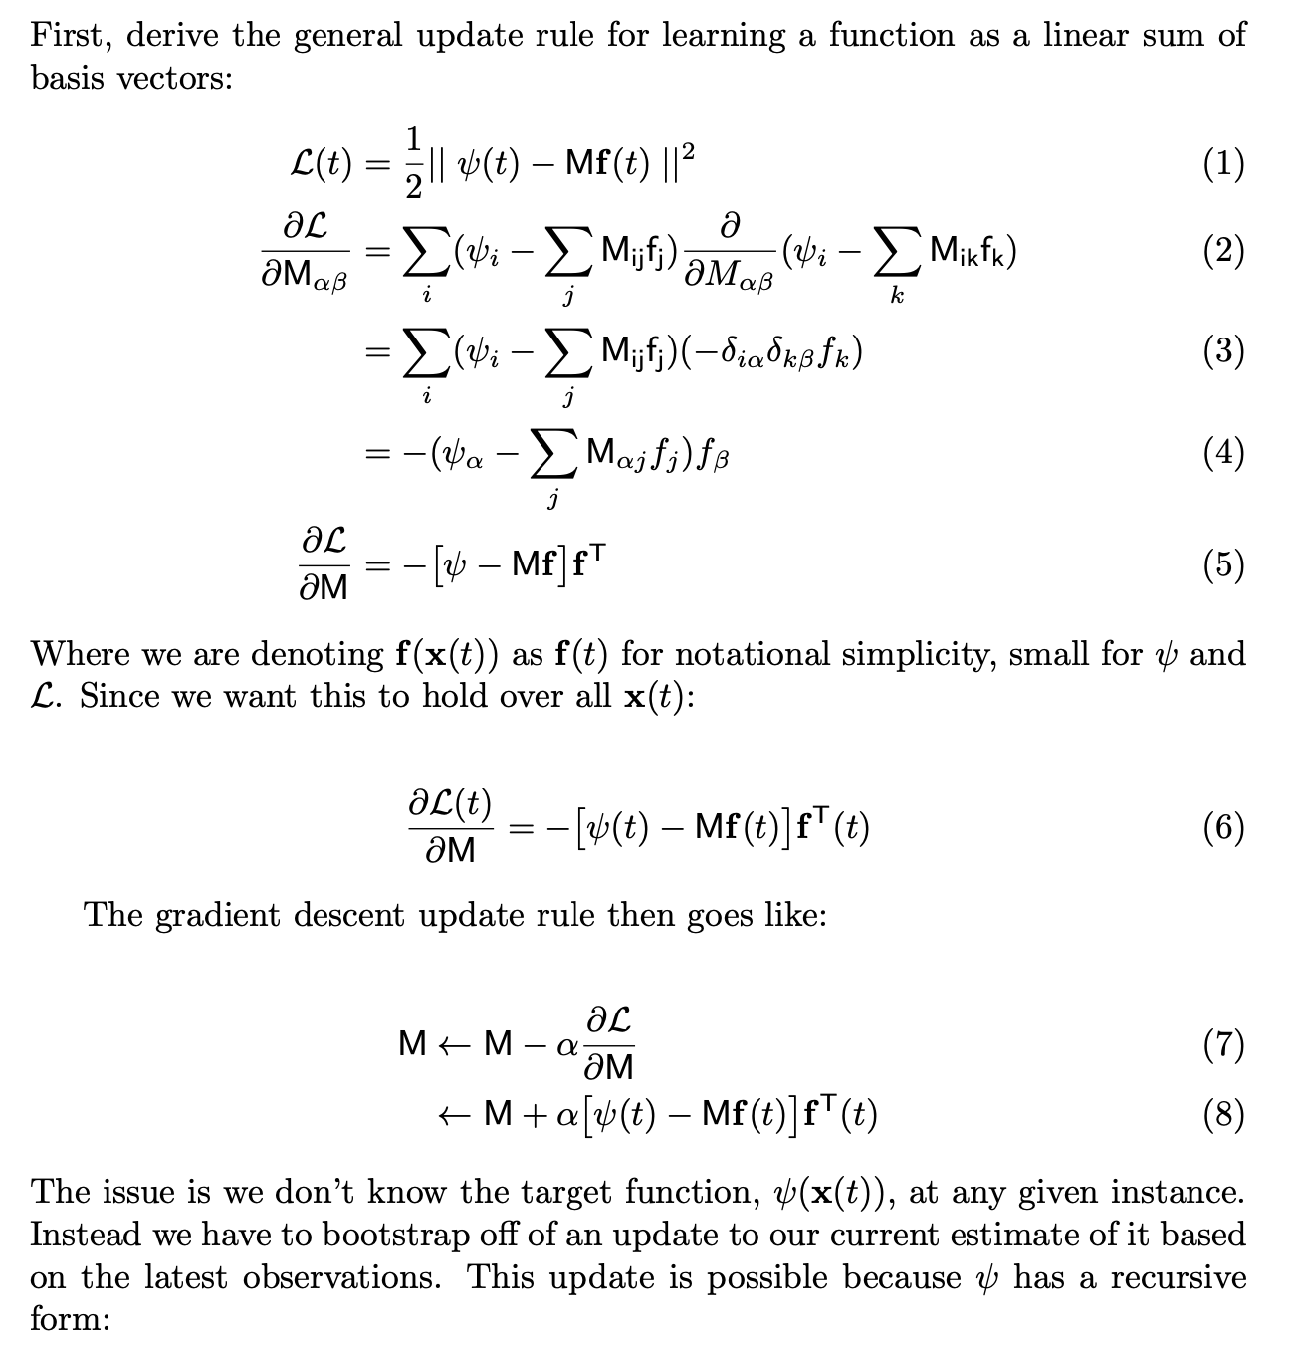
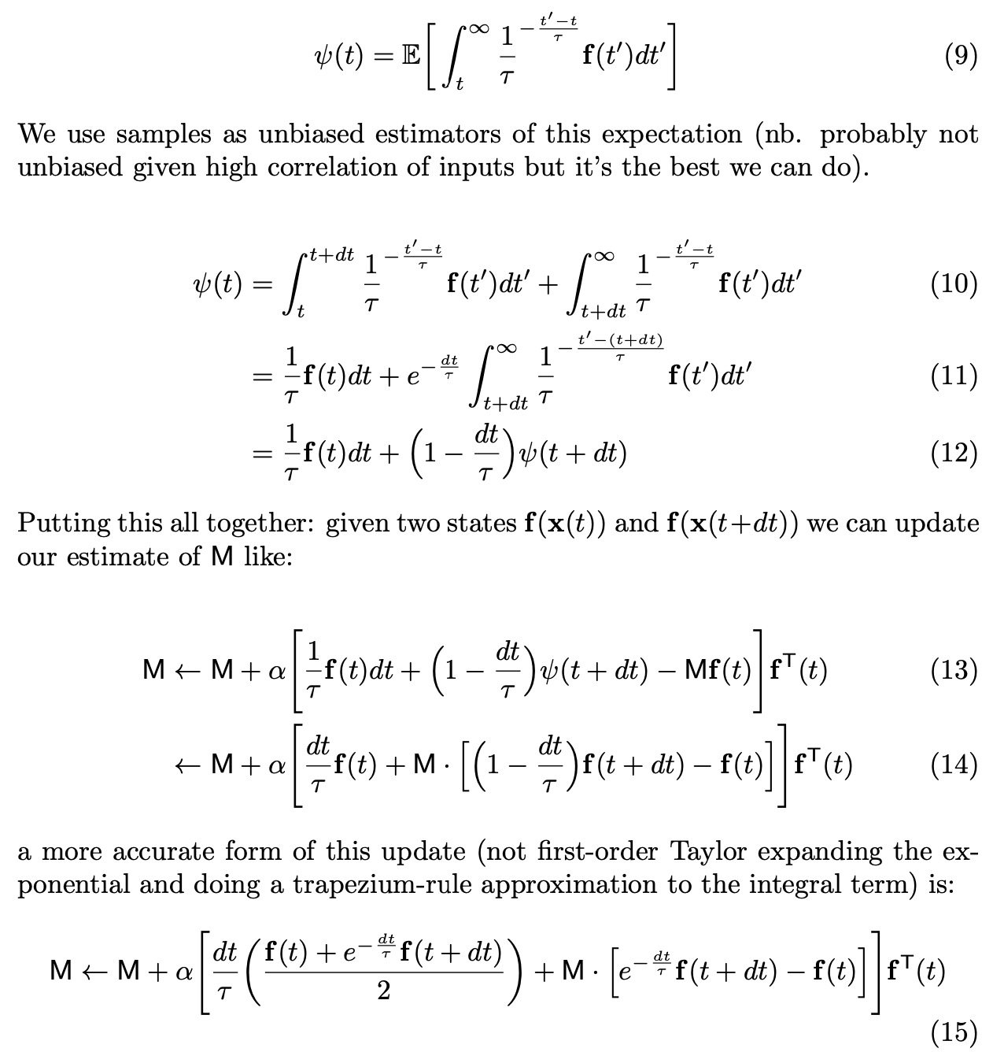
Full derivation:

Slide 54
Intuition for learning rule:
Definition:
TD update:
Discrete time steps:
γ
f(t)
t
t+1
t+2
• • •
1

Slide 55
Intuition for learning rule:
Definition:
TD update:
Discrete time steps:
γ
f(t)
t
t+1
t+2
• • •
1
Continuous time:
exp (- dt / τ) = (1 - dt / τ)
f(t)/τ
dt

Slide 56
Intuition for learning rule:
Definition:
TD update:
Discrete time steps:
γ
f(t)
1
t
t+1
t+2
• • •
Continuous time:
exp (- dt / τ)
f(t)/τ
exp (- dt / τ)
f(t+dt)/τ
dt

Slide 57
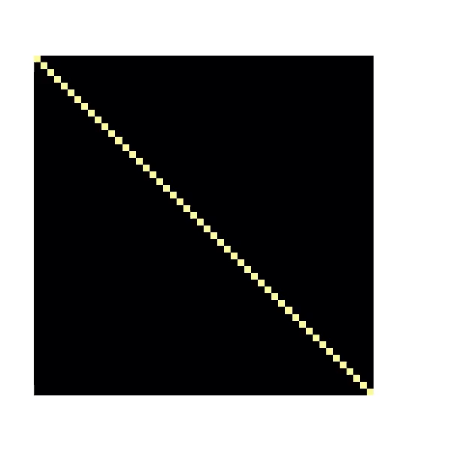

Slide 58
In practice it’s hard to train on scattered place fields

Slide 59
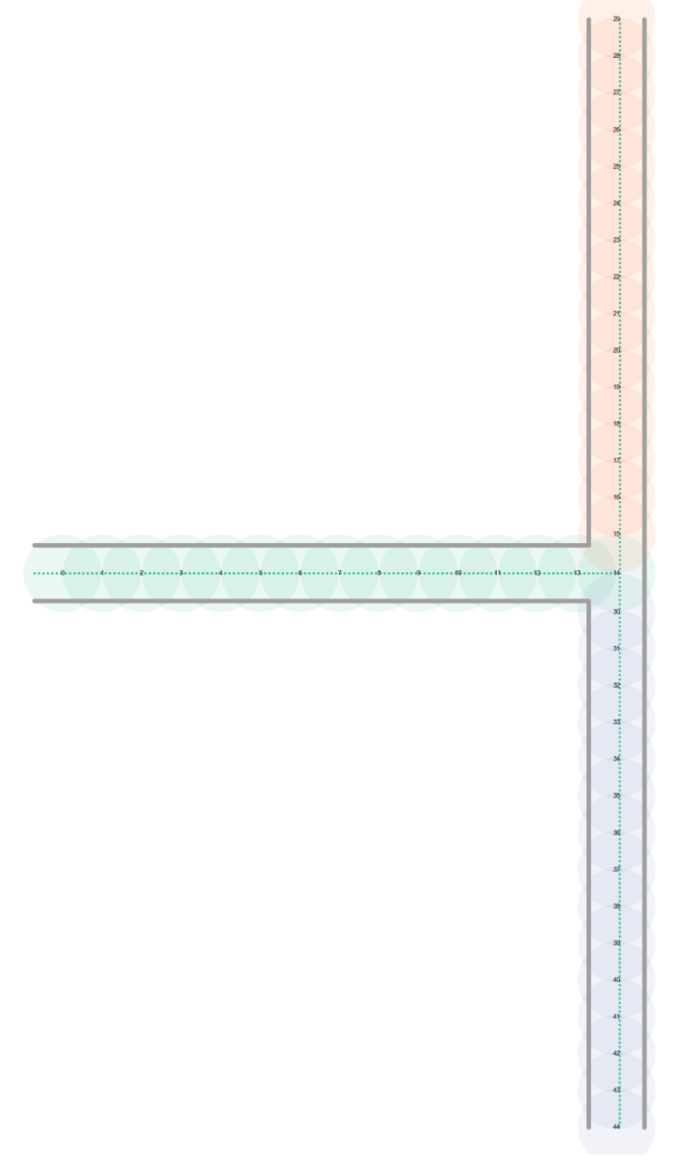
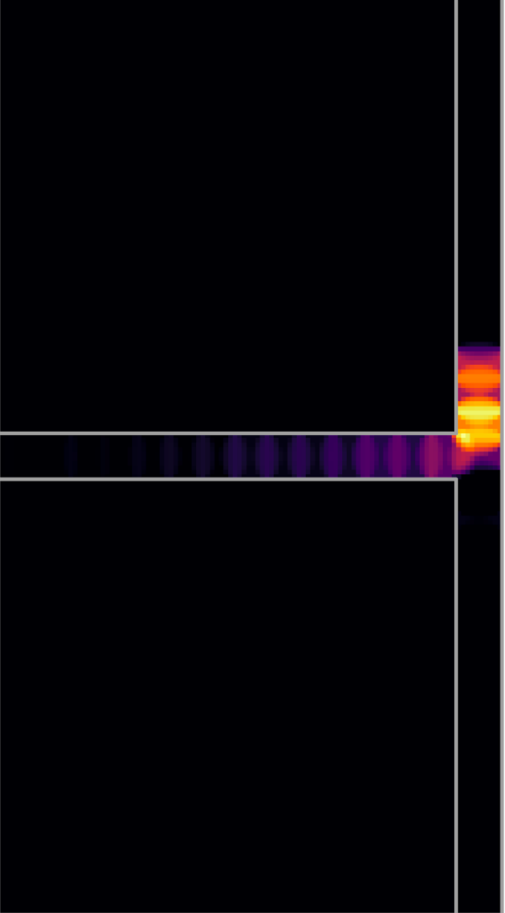
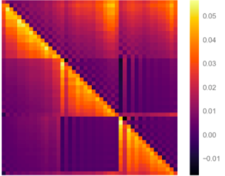
T-Maze

Slide 60

Some back of the envelope calculations
Theta sweeps forward one place cell distance, σ_{PC}, each cycle lasting T_{θ}
STDP binding occurs for τ_{STDP} of this
Distance into the future a cell can be bound:
“Time” into the future a rat can forecast:
This should be:
Roughly constant
O(few seconds) at least

Slide 61
It may be ~ constant though
20ms
1m
﻿Whishaw and Vanderwolf, 1973
8Hz
0.1m/s
Some solutions:
Very large place cells do exist
STDP learning restricted to rare ‘long range sweeps’
Maybe 1-2s SR is enough
Jeewajee & Barry et al., 2008
Jeewajee & Barry et al., 2008
﻿Maurer et al., 2012
(similar but not strictly what they found)

Slide 62
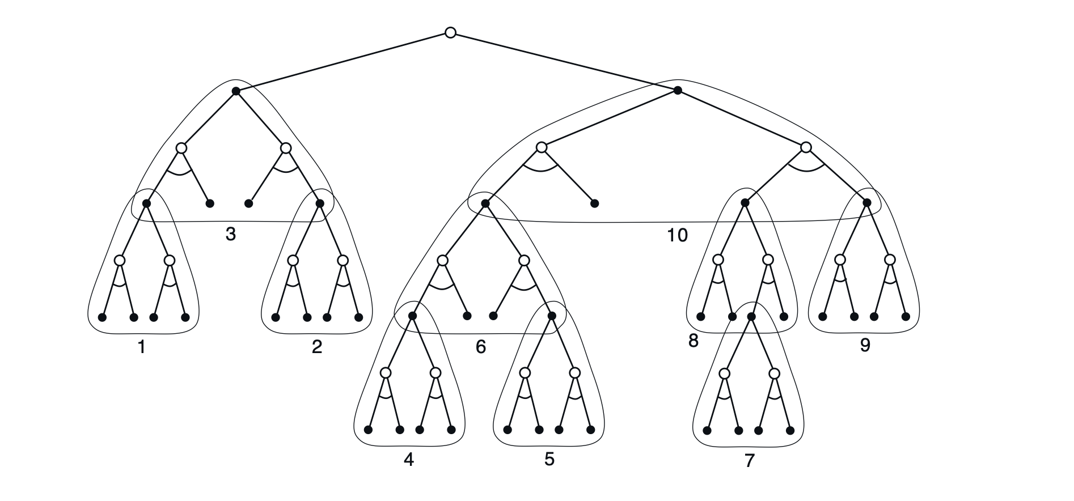
Summaries from reading this week:
Utility of ‘approximation’ to SR
“Approximate SR” is probably a useful thing to learn (Gerchman 2018). Either:
Model based RL “searches” to a certain depth then uses approximate SR for heuristic to plug the gap →
Approx SR-based value function provides starting point for more thorough model-based methods.

Slide 63
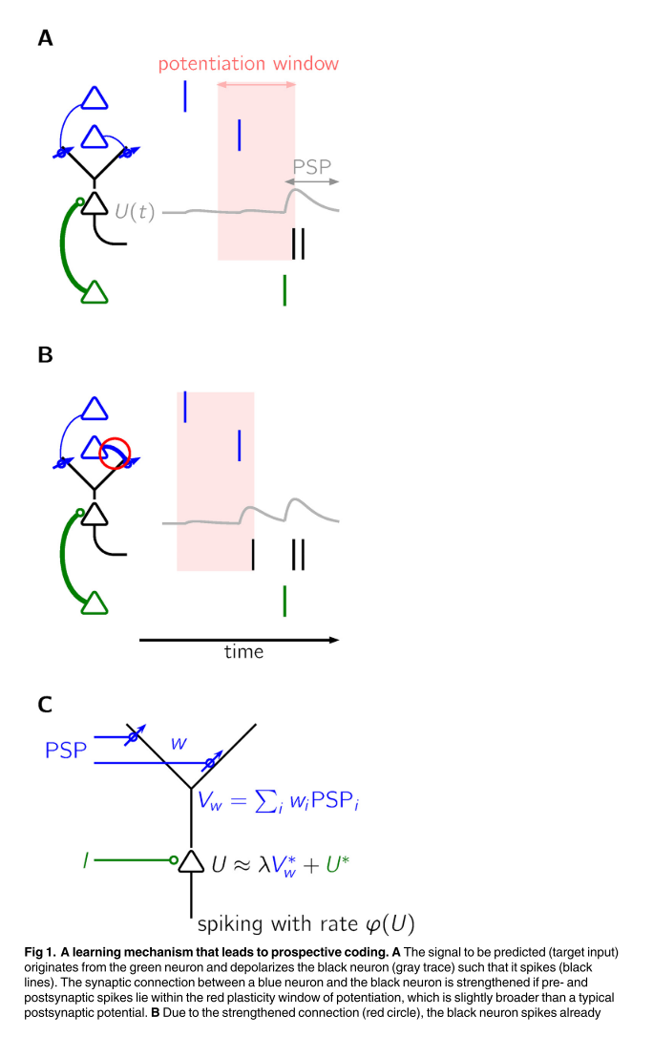
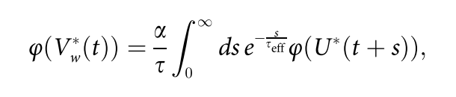
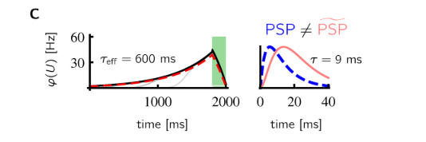
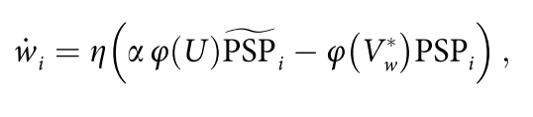

Summaries from reading this week:
Prospective coding of spiking neurons
STDP rule on two-compartment neurons learns to ‘predict’ future firing of neuron over time scale of seconds (vs STDP timescale of 10s of milliseconds
The form of output is almost identical to our analytic form for SR
The paper does not make reference to this (it was 2016)
Though Gerchman does point this out.
Either:
We could use this to try explain timescale mismatch
Alternative STDP learning rule not requiring theta sweeps
DENDRITIC OUTPUT:
LEARNING RULE:

Slide 64

Testing dorsal-ventral hypothesis SR scales
dorsal
ventral
dorsal
STDP learned SR matrix
Place cells of different size don’t bind
Place cells of same cell bind
Small dorsal cells → short time scale SR
Large ventral cells → long time scale SR
ventral

Slide 65
I fixed the loop issue for STDP

Slide 66



Multiscale SRs reveals distance information unavailable in single scale SR
Restaurant 2
Restaurant 1
Ambiguous whether:
• R2 is preferred over R1
• R2 is closer than R1
30 minutes
Work
10 minutes
With both 5min and 60min SRs, there is no ambiguity:
R2 must be further away than R1, but preferred.

Slide 67
Topographical organization matters
M_{ij}
γ
Momennejad et al. (2018) show it’s infact the gradient of the SR wrt gamma which can be used to extract information about distance between states and future trajectories
This information can be ‘read out’ in a neurally plausible way (I have read it that deeply yet)
Point is: It’s not enough just to store several timescale SRs, they must be arranged topographically, e.g. along dorsal-ventral axis
Bonus: It could be the theta wave sweeping down the HPC which read’s out these gradients.

Slide 68
Our contribution
Them: multiscale could be stored in HPC.
Us: this pops out naturally from our STDP learning rule
Them: state it is possible gradient of PC size corresponds to gradient of time horizon (no justification)
Us: We formalize this relationship in STDP setting (tau ~ place field)
Them: gradient readout built onto conveniently existing PC size axis
Us: Our ‘binding model’ would result in continuum of PC sizes to minimize binding energy

Slide 69



Truncation emphasizes place cell behavioural biasing
Half max width ratio = 1.13
Half max width ratio = 2.14
We might consider using global threshold (e.g. 0.8Hz) rather than cell-specific threshold (0.8*cell max) as in Wills paper

Slide 70


Figures 1 and 2 (first draft):
1.
2. STDP approximates SR matrix
a) 1D maze (closed)
b) 1D loop (open)
c) 2D 2-rooms, linking doorway
1. STDP model and intuition
a) Place cells and raster plot
b) Theta precession
c) STDP weight updates
d) Schematic binding strengths
e) Schematic SR

Slide 71


Figures 3 and 4
4. Place cells show expected properties
a) Skewing against behavioural motion
b) Elongating along walls
c) Spreading through doorways
3. Multiscale SR down dorsal-ventral axis
a) Place cells width maps onto SR timescale
b) Larger place cells down HPC axis
c) STDP matrix only binds cells of similar size, decomposing SR matrix into a continuum of timescales

Slide 72



Slide 73

Figure 1 draft

Slide 74
1D: STDP vs TD_{onehot} vs TD_{gaussian features}
Place cell size = 20cm
Place cell size = 40cm ☹

Slide 75
2D SR:
TD-SR
Radial ‘ordering’

Slide 76
Semi-analytic solution
Consider two basis sets of neurons, alpha (e.g. onehots) and beta (e.g. gaussian features)
N_{β}
N_{β} x N_{α}
N_{α}
N_{α} x N_{β}
U is the matrix which converts onehot firing rates to feature cell firing rates.
By virtue of alpha being onehot, U is easy to define (it’s just the beta firing rates at all the one hot centres)

Slide 78
Sigma = 0.1m (TD vs. semi-analytic)
Sigma = 0.5m
Wont converge

Slide 79
Reward
γ • nextValue
currentValue
Our original choice
‘normalises’ ψ

Slide 80

Comparisons: (i) Open loop
STDP
τ=2s
τ=5s
τ=10s
onehot
σ=0.2m
σ=1m
Convergence issues solved, but banding problems now

Slide 81

Gaussian vs Bump (cross at y = 0.5)
I.e. same FWHM

Slide 82



Analytic solution to 1D maze
Basis feature
Successor feature
Note shifted peak

Slide 83

Linear regression to find M_{ij} against analytic solution
Find successor feature, y…
…as linear sum of…
…basis features, x
Our TD algorithm effectively tries to find this analytic solution AND solve the linear regression in one go.
Conclusion: solutions only stable for small number of basis cells. Otherwise the problem is overconstrained.
Second conclusion: we focus on M when in fact, ψ, is the only important and uniquely defined thing

Slide 84
Linear regression to find M_{ij} against analytic solution
Analytic solution teaches us:
Successor matrix has structure (surprisingly!)
Regularisation is crucial
M does go negative
+L₂ Regularisation

Slide 85

Back to TD… but learning from analytic solution; Add regularisation
…

Slide 86

No reg
Weak reg
STDP
Negative band to the right of diagonal due to depression is additionally predicted by true regularised TD solution

